Slide 1
Chapter 2
Programming Technique

Slide 2
Programming technique
Programming technique is a systematic approach to analyze the problem and write the corresponding code in any platform to solve the problem.
There are various approach to programming which we will discuss below:

Slide 3
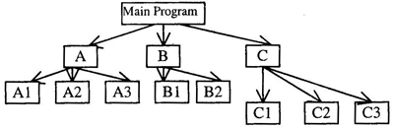
Top down approach
The large program is divided into many small module or subprogram or function or procedure from top to bottom.
At first supervisor program is identified to control other sub modules. Main modules are divided into sub modules, sub-modules into further sub modules.
The decomposition of modules is continuing whenever desired module level is not obtained.
Top module is tested first, and then sub-modules are combined one by one and tested.
Example: The main program is divided into sub-program A, B, and C. The A is divided into subprogram A1, A2 and A3.The B is into B1, and B2. Just like these subprograms, C is also divided into three subprogram C1, C2 and C3. The solution of Main program is obtained from sub program A, B and C.

Slide 4
Bottom up approach
In this approach designing is started from bottom and advanced stepwise to top. So, this approach is called Bottom up approach.
At first bottom layer modules are designed and tested, second layer modules are designed and combined with bottom layer and combined modules are tested. In this way, designing and testing progressed from bottom to top.
In software designing, only pure top down or Bottom up approach is not used. The hybrid type of approach is recommended by many designers in which top down and bottom up, both approaches are utilized.

Slide 5
Difference between top down vs bottom up
Top down
Bottom up
Top down approach begins with high level design and ends with low level design or development.
Structure/procedure oriented programming languages like C programming language follows top down approach.
We focus on breaking up the problem in smaller parts
Bottom up approach begins with low level design or development and ends with high level design.
Object oriented programming languages like C++ and Java programming language follows bottom up approach.
We solve small problems and integrate it as a whole and compute the solution

Slide 6
Cohesion vs coupling
Software can be visualized as a multiple independent modules.
A module is a set of instructions put together to perform a certain task.
If the system is divided into multiple modules (modularization) then it is:
Easy to understand the system
System maintenance is easy
Reuse
The measure used to identify the quality of a module and interaction among them is called cohesion and coupling.

Slide 7
Cohesion vs coupling
Cohesion:
Cohesion is a measure of the degree to which the elements of the module are functionally related.
Cohesion is about how well elements within a module belong together and serve a common purpose.
A good software design will have high cohesion.
Low cohesion: functionalities of a module are independent of each other
High cohesion: functionalities of a module are strongly related

Slide 8
Cohesion vs coupling
Coupling:
Coupling is the measure of the degree of interdependence between the modules.
Coupling is about how much one module depends or interacts with other modules.
A good software will have low coupling.
High coupling: module has many relationships with other modules
Low coupling: module has fewer relationships with other modules
Low coupling leads to greater readability and maintainability.

Slide 9
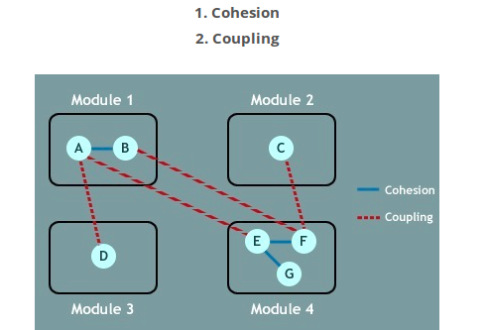
Cohesion vs coupling

Slide 10
Comparison between cohesion and coupling
Cohesion | Coupling
Cohesion is the indication of the relationship within module | Coupling is the indication of the relationships between modules
Cohesion shows the module’s relative functional strength | Coupling shows the relative independence among the modules
Cohesion is a degree (quality) to which a component / module focuses on the single thing | Coupling is a degree to which a component / module is connected to the other modules
While designing we should strive for high cohesion. Ex: cohesive component/module focus on a single task with little interaction with other modules of the system | While designing we should strive for low coupling. Ex: dependency between modules should be less
Cohesion is Intra – Module Concept | Coupling is Inter -Module Concept

Slide 11
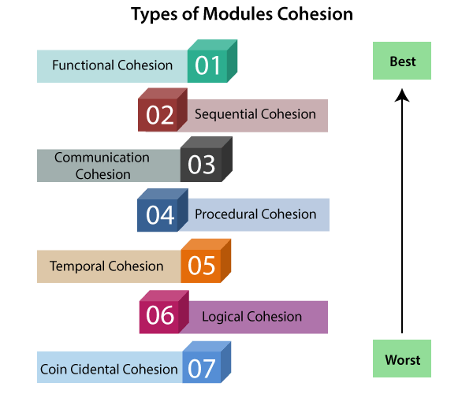
Types of cohesion
Functional cohesion - This the best and the most preferred type of cohesion in which the degree of cohesion is the highest. In this type of cohesion, the elements of a module are functionally grouped into a logical unit and they work together as a logical unit. This also promotes flexibility and reusability.
Sequential cohesion: Similar to procedural cohesion with the additional constraint that the execution sequence is important. An element output some data that that is input for another element. For example, call readFile() before calling processData().
Communicational cohesion: When parts of a module are grouped because they operate on the same data (e.g., a module which operates on the same record of information).

Slide 12
Types of cohesion contd…
Procedural cohesion: When parts of a module are grouped because they always follow a certain sequence of execution (e.g., a function which checks file permissions and then opens the file).
Temporal cohesion: Parts that are executed when something happens, such as start-up or clean-up routines. Code changes may affect many modules.
Logical cohesion: Logical cohesion is when parts of a module are grouped because they are logically categorized to do the same thing even though they are different by nature (e.g., grouping all mouse and keyboard input handling routines).
Coincidental cohesion: Parts are not related and just happen to be in the same module. Such a module is hard to understand, maintain or reuse.

Slide 13
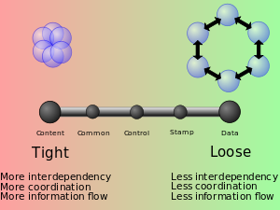
Types of coupling
A module here refers to a subroutine of any kind, i.e. a set of one or more statements having a name and preferably its own set of variable names.
Content coupling (high)
Content coupling is said to occur when one module modifies the local variable of another module or one module uses the code of another module, for instance a branch. This violates information hiding – a basic design concept.
Common coupling
Common coupling is said to occur when several modules have access to the same global data. But it can lead to uncontrolled error propagation and unforeseen side-effects when changes are made.
Control coupling
Control coupling is one module controlling the flow of another, by passing it information on what to do (e.g., passing a what-to-do flag).

Slide 14
Types of coupling contd…
Stamp coupling (data-structured coupling)
Stamp coupling occurs when modules share a composite data structure and use only parts of it, possibly different parts (e.g., passing a whole record to a function that needs only one field of it).
Data coupling
Data coupling occurs when modules share data through, for example, parameters. Each datum is an elementary piece, and these are the only data shared (e.g., passing an integer to a function that computes a square root).

Slide 15
Structured programming
The execution sequence follows the sequence in which the code is written.
On the contrary, statements in assembly languages do not get executed in a structured manner. (use of GOTO statements)
The structured program consists of well structured and separated modules
A structured program is well maintained, neat and clean.
Structured program uses single entry and single exit e.g. C Program.
The structured program mainly consists of three types of elements:
Sequence Statements
selection Statements
Iteration Statements

Slide 16
Advantages of Structured Programming Approach:
Easier to read and understand
User Friendly
Easier to Maintain
Mainly problem based instead of being machine based
Development is easier as it requires less effort and time
Easier to Debug
Machine-Independent, mostly.

Slide 17
Disadvantages of Structured Programming Approach:
Since it is Machine-Independent, So it takes time to convert into machine code.
Change of even a single data structure in a program necessitates changes at many places throughout it, and hence the changes becomes very difficult to track even in a reasonable sized program.
Usually the development in this approach takes longer time as it is language-dependent. Whereas in the case of assembly language, the development takes lesser time as it is fixed for the machine.
Can support the software development projects easily up to a certain level of complexity. If complexity of the project goes beyond a limit, it becomes difficult to manage.

Slide 18
Structured vs Unstructured Programming
Structured Programming is a programming paradigm which divides the code into modules or function. | Unstructured Programming is the paradigm in which the code is considered as one single block.
Readability
Structured Programming based programs are easy to read. | Unstructured Programming based programs are hard to read.
Purpose
Structured Programming is to make the code more efficient and easier to understand. | Unstructured programming is just to program to solve the problem. It does not create a logical structure.
Complexity
Structured Programming is easier because of modules. | Unstructured programming is harder when comparing with the structured programming.
Application
Structured programming can be used for small and medium scale projects. | Unstructured programming is not applicable for medium and complex projects.
Modification
It is easy to do changes in Structured Programming. | It is hard to do modifications in Unstructured Programming.
Data Types
Structured programming uses many data types. | Unstructured programming has a limited number of data types e.g. number, array, strings.
Code Duplication
Structured programming avoids code duplication. | Unstructured programming can have code duplication.
Testing and Debug
It is easy to do testing and debugging in Structured Programming. | It is hard to do testing and debugging in Unstructured programming.
Example C | Example assembly language

Slide 19
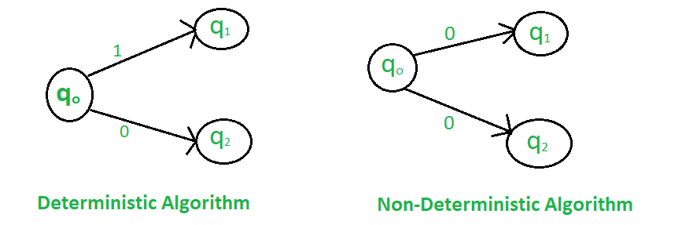
DETERMINISTIC ALGORITHM | NON-DETERMINISTIC ALGORITHM
For a particular input the computer will give always same output. | For a particular input the computer will give different output on different execution.
Can determine the next step of execution. | Cannot determine the next step of execution due to more than one path the algorithm can take.

Slide 20
Deterministic and non deterministic function
Deterministic functions always return the same result any time they are called with a specific set of input values and given the same state of the database.
Nondeterministic functions may return different results each time they are called with a specific set of input values even if the database state that they access remains the same.
For example, the function AVG always returns the same result given the qualifications stated above, but the GETDATE function, which returns the current datetime value, always returns a different result.

Slide 21
Recursion vs iteration logic
Approach
In recursive approach, the function class itself until the condition is met whereas, in iteration approach, a set of instructions repeats until the condition fails.
Programming construct usage
Recursive algorithm uses a branching structure, while iterative algorithm uses a looping construct.
Time & space effectiveness
Recursion solutions are less efficient in terms of time and space when compare to iterative solution (Invoking the same method over and over again can be expensive in terms of CPU and memory).
Line of code
Recursion makes code smaller while iteration makes it longer.
Termination test
Recursion terminates when the base case is recognized whereas iteration terminates when the loop-continuation condition fails.
Infinite repetition
Infinite repetition in recursion can lead to system crash but in iteration it uses the CPU cycles repeatedly.

Slide 22
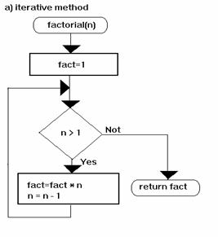
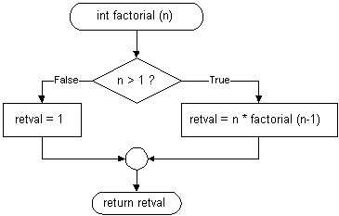
Factorial using iteration
Factorial using recursion

Slide 23
Modular programming
Modular programming is a software design technique that emphasizes separating the functionality of a program into independent modules, such that each contains everything necessary to execute only one aspect of the desired functionality.
Modular programming approach allows us to decompose big, seemingly complex systems into small, manageable parts.

Slide 24
Benefits of Modularization
The primary benefit of modularization is mastering the art of managing software complexity. Some of the important benefits are mentioned below:
understandability: A well-modularized system is much easier to understand.
improvability: Strongly encapsulated modules maximizes your ability to fix or improve individual module implementations without needing to update any other, dependent modules.
refactorability: The less inter-dependencies in a project, the easier it is to make large changes across multiple modules.
reusability: Modules with the best-conceived purposes are fully reusable. Whenever you have the same problem again, you can simply reuse the old solution.
testability: Modules with good solutions and minimal inter-dependencies are easier to test
scalability: Modules helps us to build large complex solutions. It is one of the important benefit of modularization.

